Slide 1
OWASP DEMO
Name: Rohith Parthipan
Practical Grp: P02
YouTube Link: https://youtu.be/XvfOpoj8FZU

Slide 2
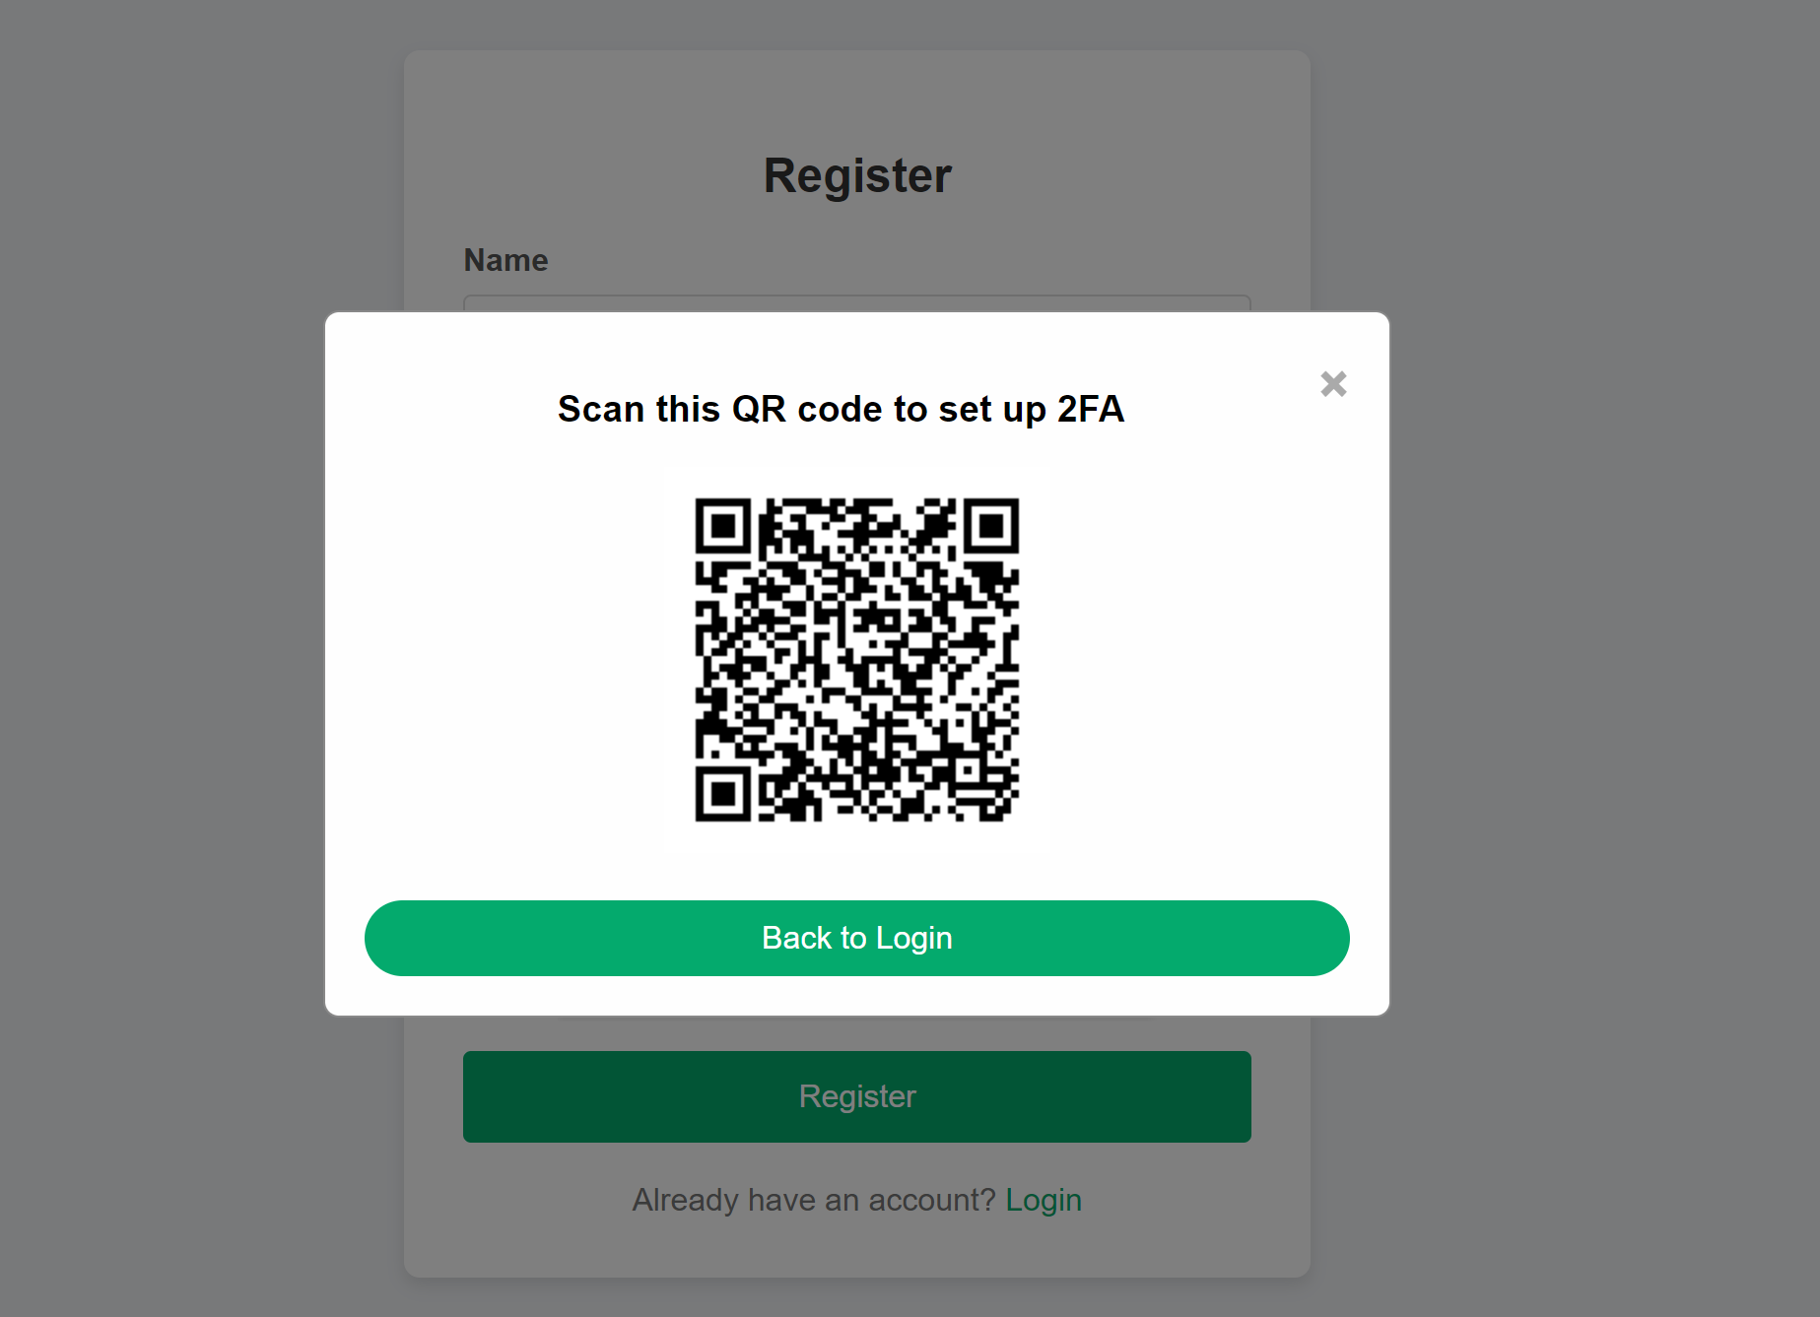
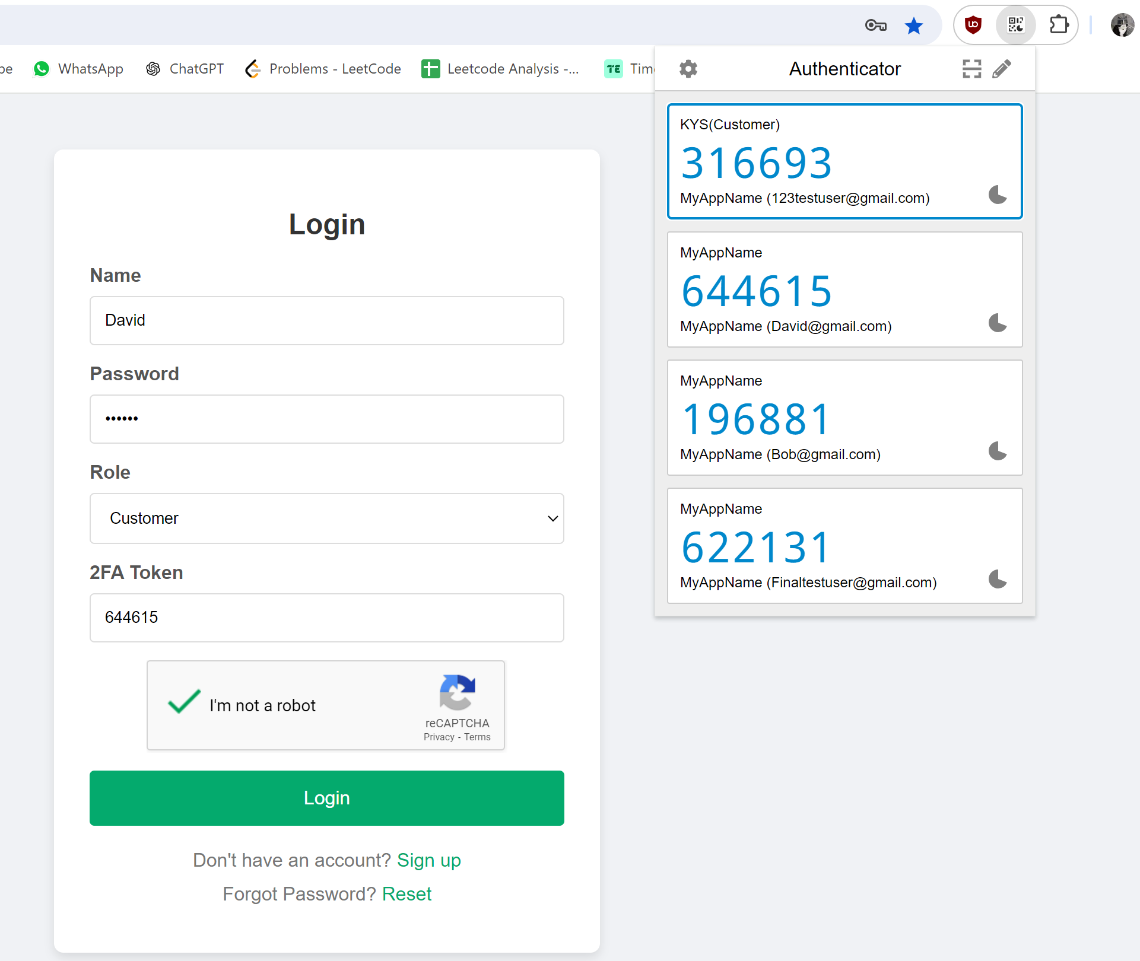
OWASP #1 - API2:2023 Broken Authentication https://owasp.org/API-Security/editions/2023/en/0xa2-broken-authentication
Vulnerability
Permits attackers to perform a brute force attack on the same user account, without presenting captcha/account lockout mechanism
How to prevent
Using a 2FA method where the user will need to enter a time-based one-time passcode to in addition to their regular login credentials
Explanation:
When the user registers they will be given a QR code to set up their 2FA which they can use google authenticator to scan to be able to get the time-base one-time token. The user will need the token to login this reduces the chances of users being able to perform a brute force attack
This 2FA method significantly reduces the chances of a successful brute force attack since, even if an attacker guesses the password, they will also need the time-sensitive one-time token, which is much harder to obtain without physical access to the user’s device.

Slide 3
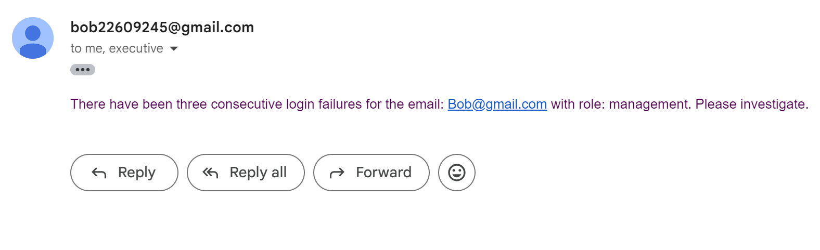
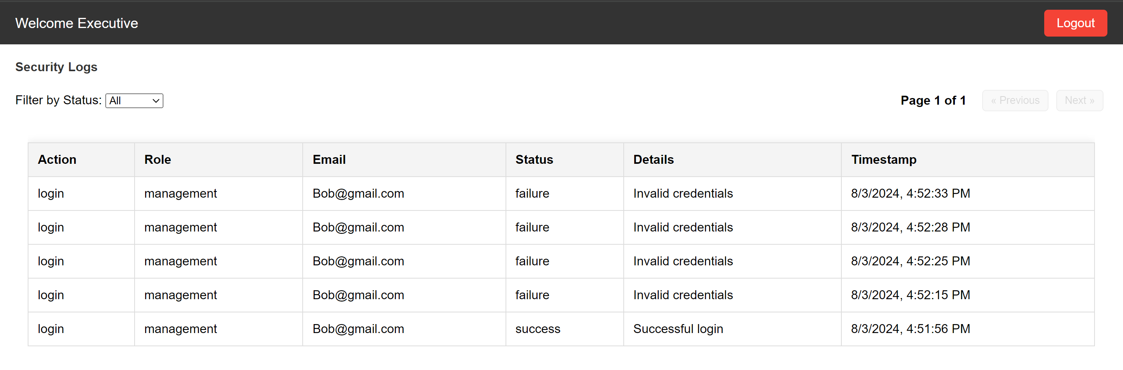
OWASP #2 - API1:2023 Unsafe Consumption of API https://owasp.org/API-Security/editions/2023/en/0xa2-broken-authentication/
Vulnerability
Appropriate alerting thresholds and response escalation processes are not in place or effective.
How to prevent
Having an audit log that is exclusive to executives(the highest role) and when there is unusual amount of failure logs for a single user at a short amount of time all the executives will be sent an email to investigate that account
Explanation
Restricting access to these audit logs to executives ensures that sensitive information is protected and only reviewed by trusted personnel and When the defined threshold is exceeded, automatically trigger an alert to Send an email notification to all executives, providing details of the suspicious activity. This prompt alert allows for immediate investigation and response to potential security threats.
By implementing this approach, the organization can quickly detect and respond to unsafe API consumption patterns, thereby reducing the risk of exploitation and ensuring the integrity of the API services.

Slide 4
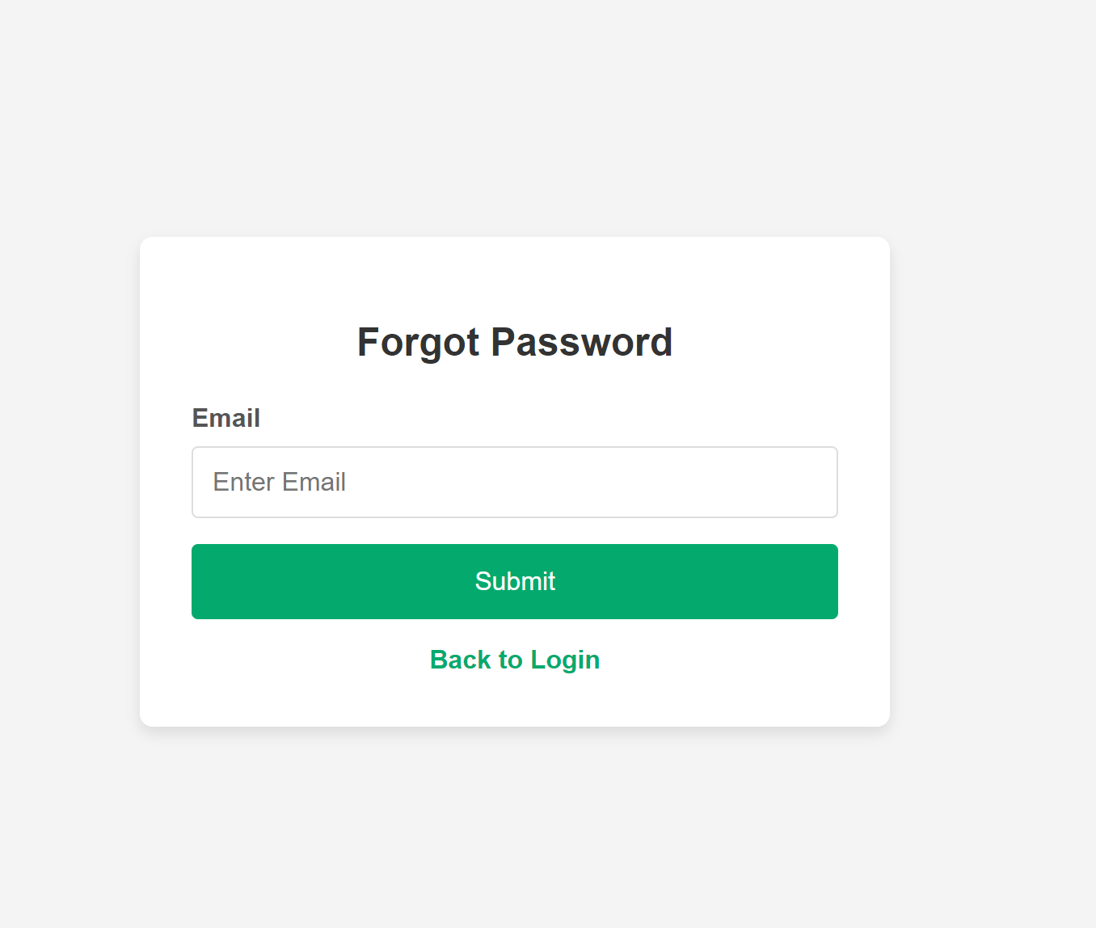
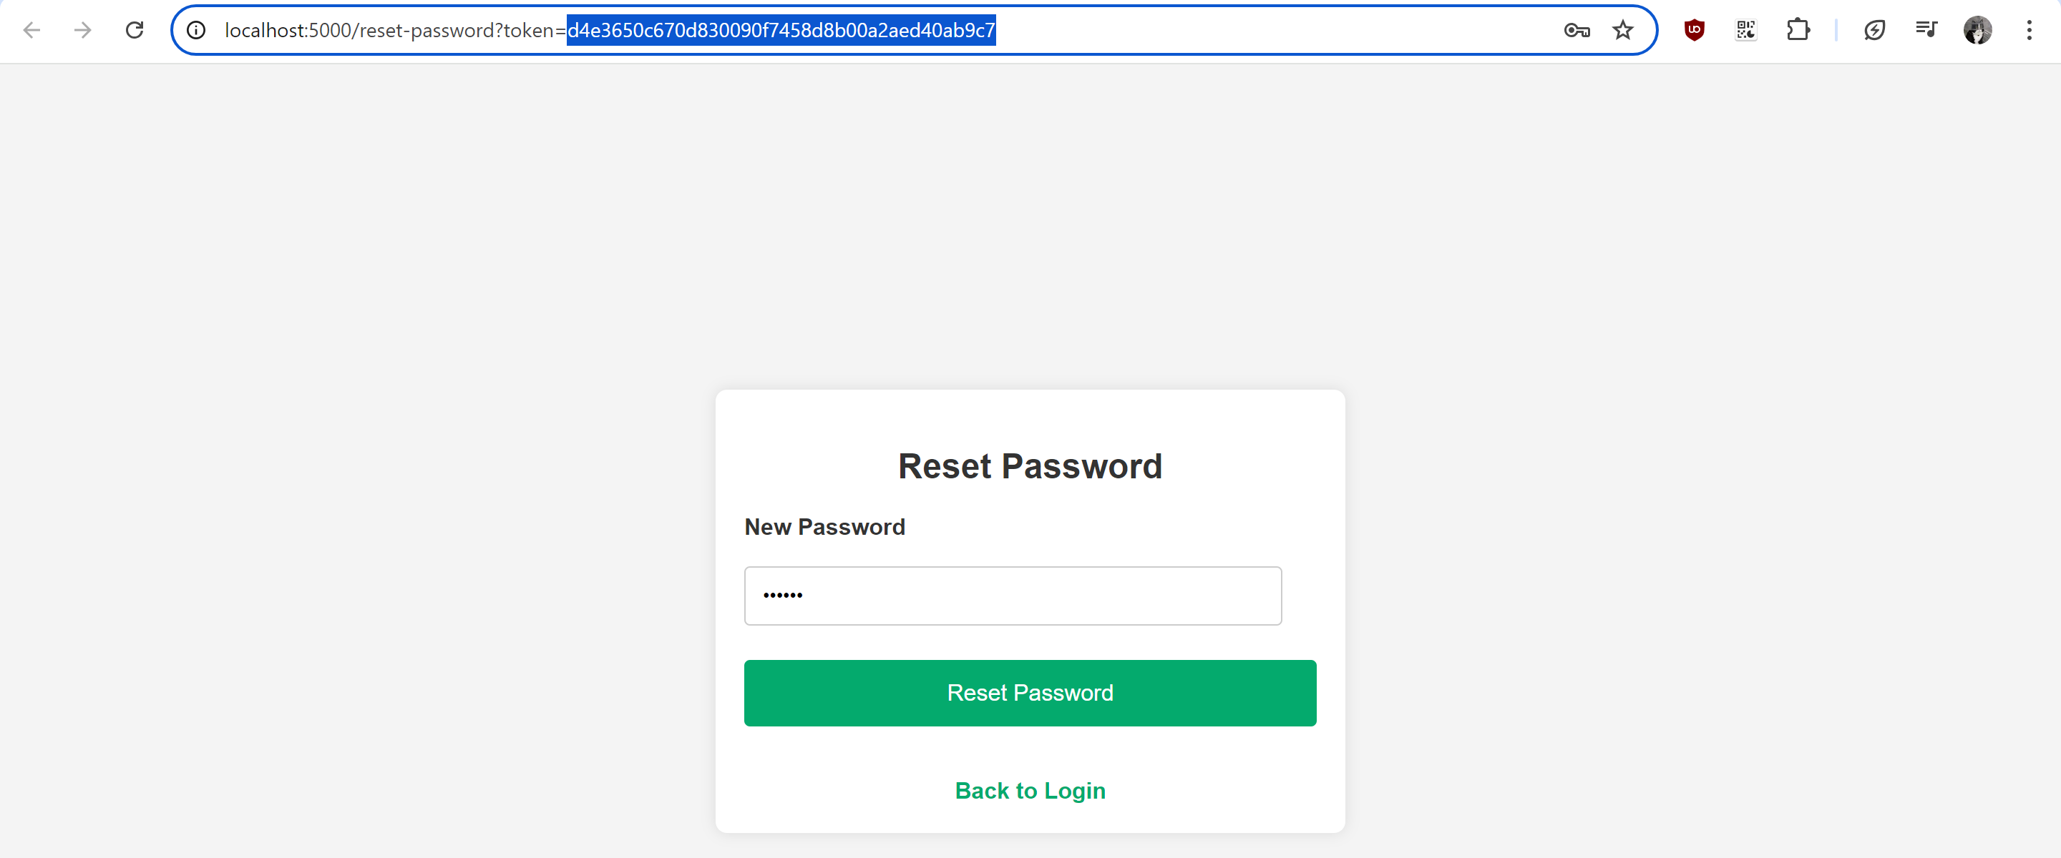
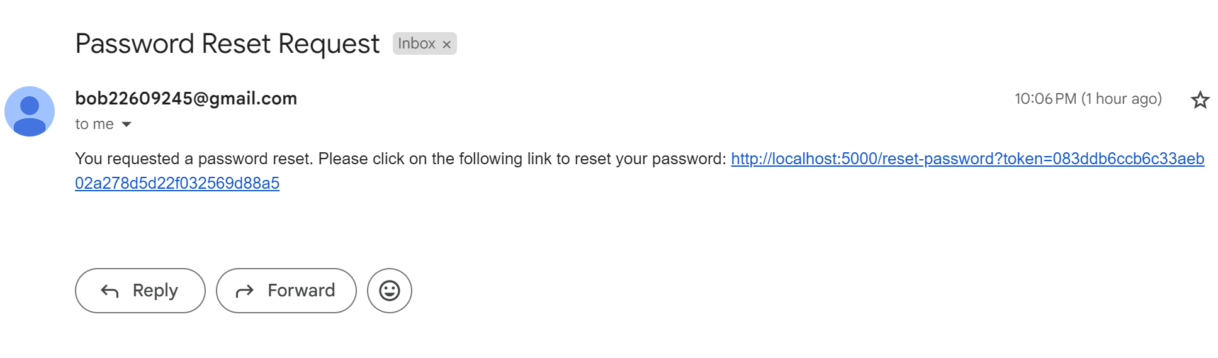
OWASP #3 - API1:2023 Broken Object Level Authorization https://owasp.org/API-Security/editions/2023/en/0xa2-broken-authentication/
Vulnerability
Permits users who don’t have access to reset the password of another user
How to prevent
Using a token in the URL which is hard to guess or recreate and will expire after a certain amount of time when sending the reset password link
Explanation:
There is a token in the URL and the token is also stored in the database with an expiry date this will prevent attackers from guessing the token for the URL this will instead and once successfully it removes the token and its expiration time from the user's record
This is so that If the password reset mechanism does not properly verify the identity of the user requesting the reset, it can be exploited by others.

